Slide 1

ChakrAi Valuation Growth Map
Market positioning, revenue targets, and growth strategy

Slide 2
Competitor Valuation Benchmarks
Wysa: ~$80 Million–$120 Million valuation, ~$30 Million funding
Woebot: ~$250 Million – $400 Million valuation, ~$123 Million funding
Both focus on B2B enterprise healthcare and insurers

Slide 3
ChakrAi Key Differentiators
Memory continuity + voice interaction
Therapist portal integration (B2B2C model)
HIPAA/GDPR compliance from the ground up
Enterprise-ready architecture with offline access (PWA)

Slide 4
ARR & Valuation Scenarios
Conservative: $8.45 Million ARR → $40 Million–$85 Million valuation
Competitive: $25.35 Million ARR → $125 Million–$250 Million valuation
Outperformer: $67.6 Million ARR → $340 Million – $675 Million valuation

Slide 5
Reverse-Engineered $500 Million Target
ARR Needed: ~$62.5 Million (at 8× multiple)
Example mix: 350 thousand B2C subs + 3,000 B2B orgs
Balanced growth over ~3 years achievable with strong sales pipeline

Slide 6
Strategic Growth Notes
B2B contracts drive ARR faster than B2C
Clinical validation raises valuation multiple
Enterprise adoption accelerates market dominance
Strong retention is critical (B2C churn < 20%, B2B churn < 8%)

Slide 7

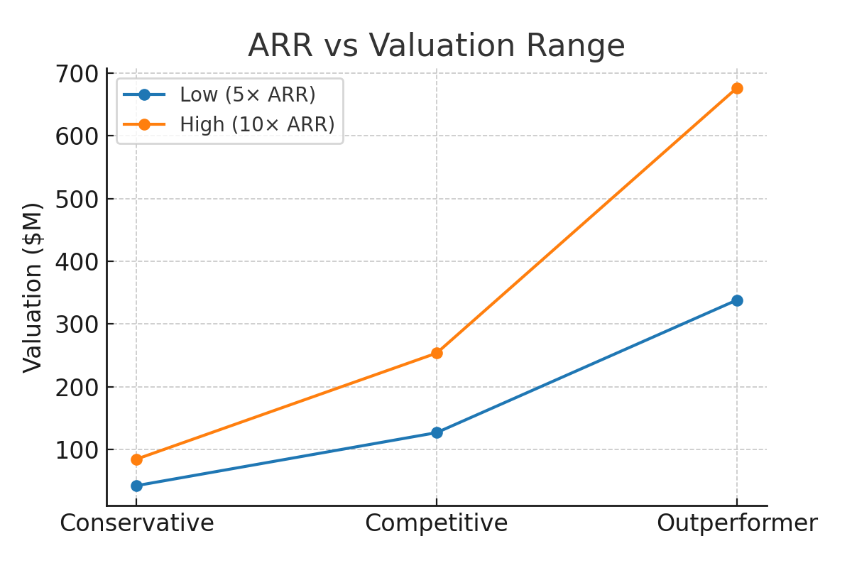
ARR vs Valuation Range

Slide 8
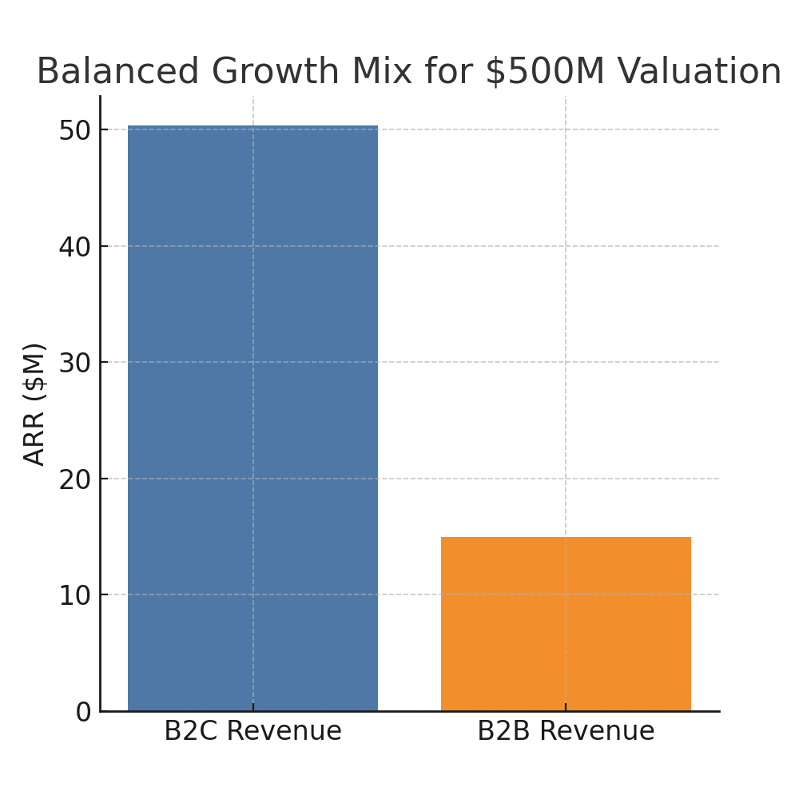
$500 Milliion Target Revenue Mix

Slide 9
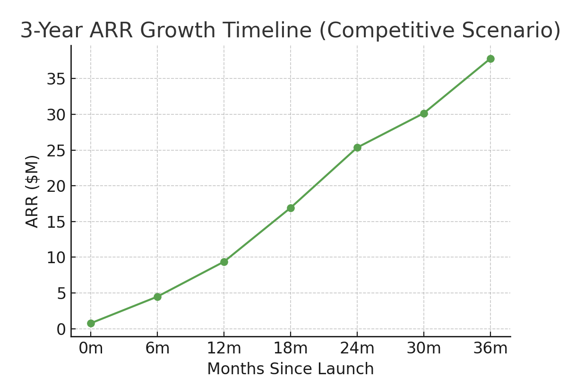
3-Year ARR Growth Timeline

Slide 10
Quarter-by-Quarter Milestone Ladder
Q1 Year 1: Launch B2C MVP, onboard 10 B2B orgs, hit 5,000 paid users
Q2 Year 1: Reach 25,000 B2C users, 100 B2B orgs, ARR $2.5 Million
Q3 Year 1: Hit 50,000 B2C, 250 B2B orgs, ARR $5 Million
Q4 Year 1: Reach 75,000 B2C, 600 B2B orgs, ARR $13.8 Million
Q1 Year 2: Hit 100,000 B2C, 900 B2B orgs, ARR $18 Million
Q2 Year 2: Reach 150,000 B2C, 1,300 B2B orgs, ARR $25 Million
Q3 Year 2: Hit 200,000 B2C, 1,800 B2B orgs, ARR $37.8 Million
Q4 Year 2: Reach 250,000 B2C, 2,200 B2B orgs, ARR $45 Million
Q1 Year 3: Hit 300,000 B2C, 2,500 B2B orgs, ARR $52 Million
Q2 Year 3: Reach 325,000 B2C, 2,700 B2B orgs, ARR $57 Million
Q3 Year 3: Hit 350,000 B2C, 3,000 B2B orgs, ARR $65 Million +
Q4 Year 3: Sustain growth, position for $500 Million valuation or acquisition

Slide 11
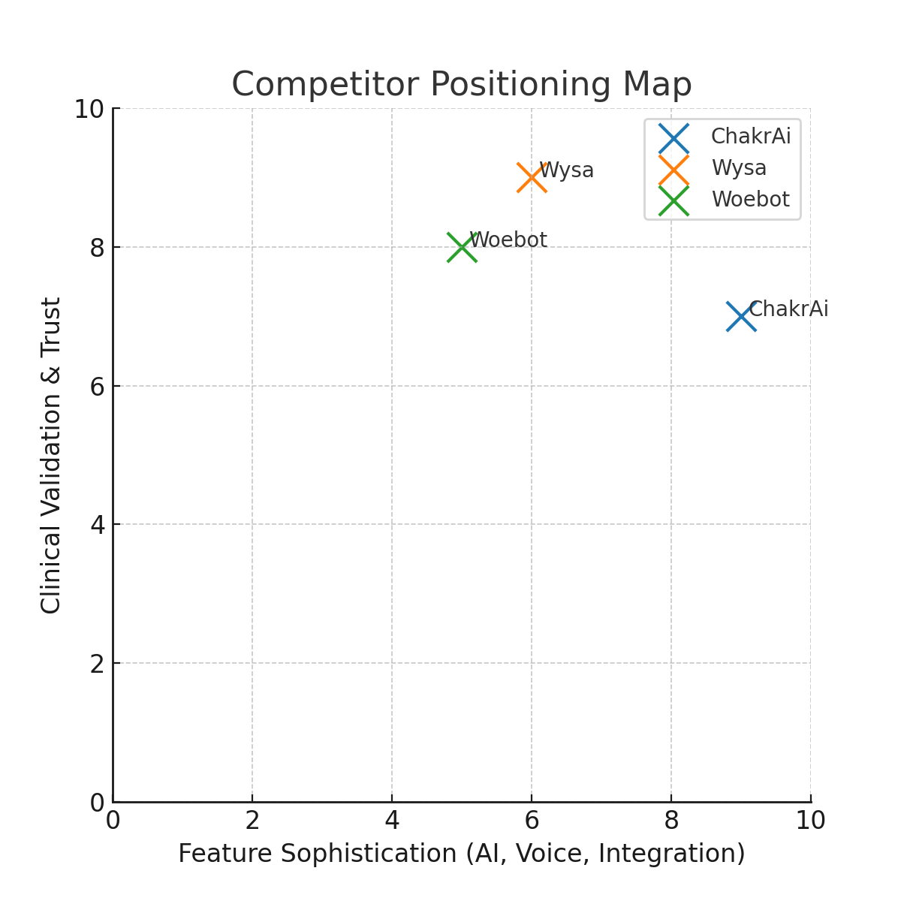
Competitor Positioning Map

Slide 12
Why We Win
Superior Feature Set: Voice AI, memory continuity, therapist portal integration
Compliance-First Design: HIPAA/GDPR ready from day one, enterprise-grade security
Dual Market Approach: Consumer + Enterprise for diversified, scalable revenue
High ARR Potential: $62 Million + achievable within 3 years for $500 Million + valuation
Strategic Advantage: Outpaces Wysa & Woebot in tech sophistication and versatility
Scalable Infrastructure: PWA architecture, offline access, ready for global adoption

